Slide 1
Production of Steel from Lunar Regolith from Carbonyl Iron Refining

Slide 2
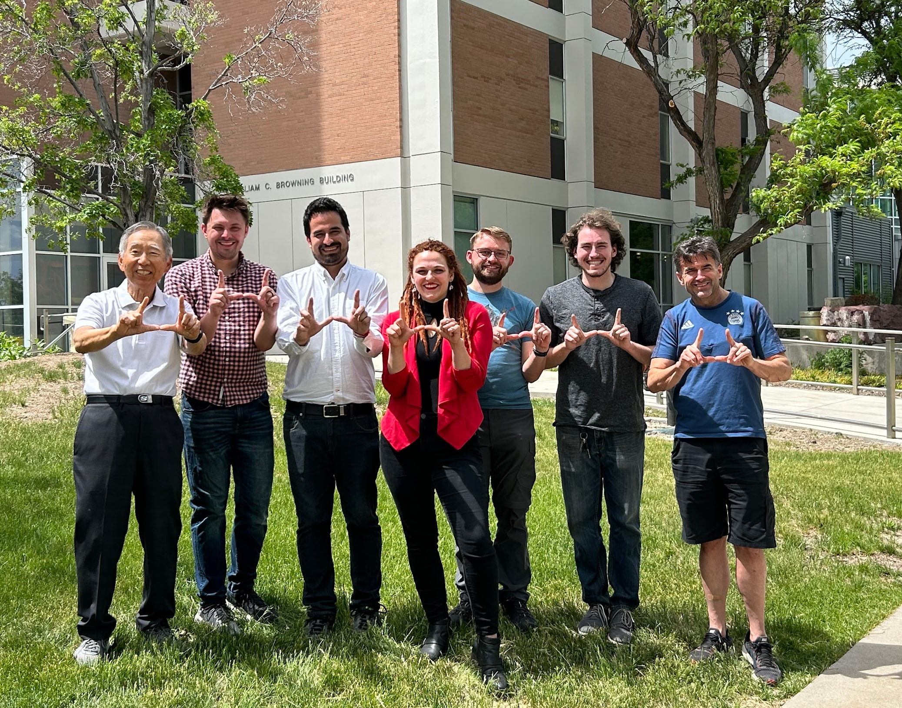
Our Team
Faculty Advisors
Industry Partner
Hong Yong Sohn
Michael F. Simpson
Zhigang Zak Fang

Slide 3
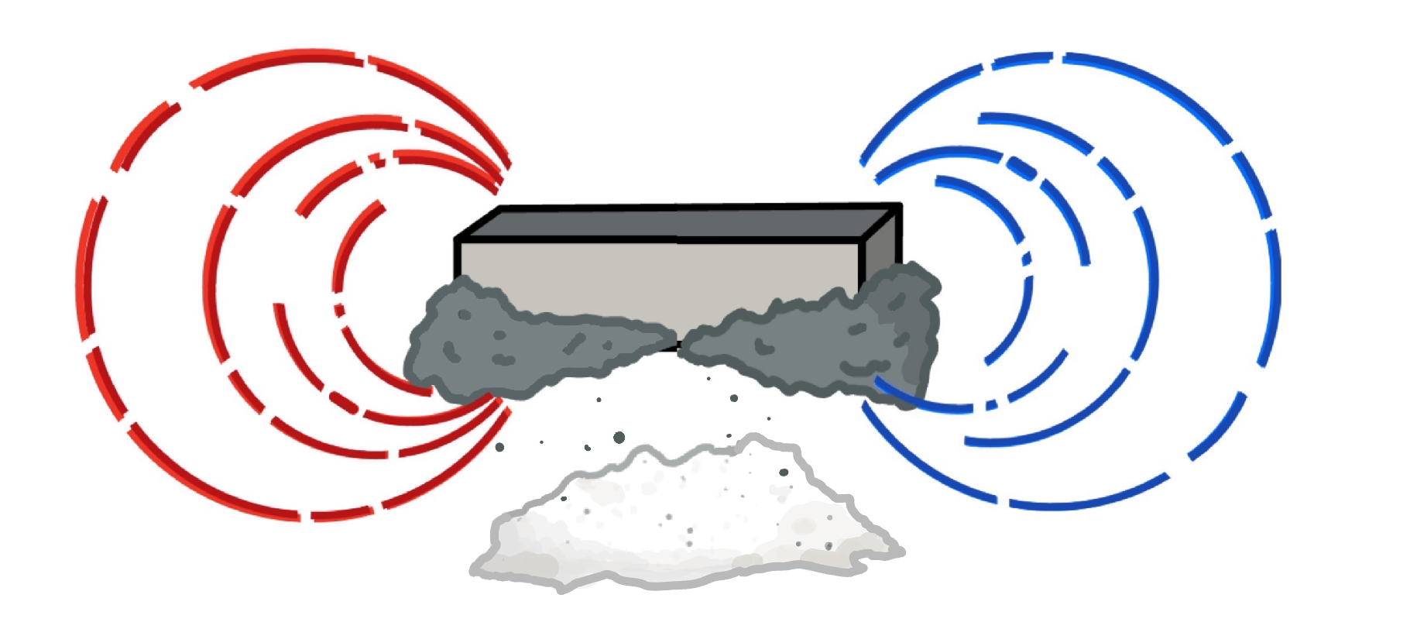
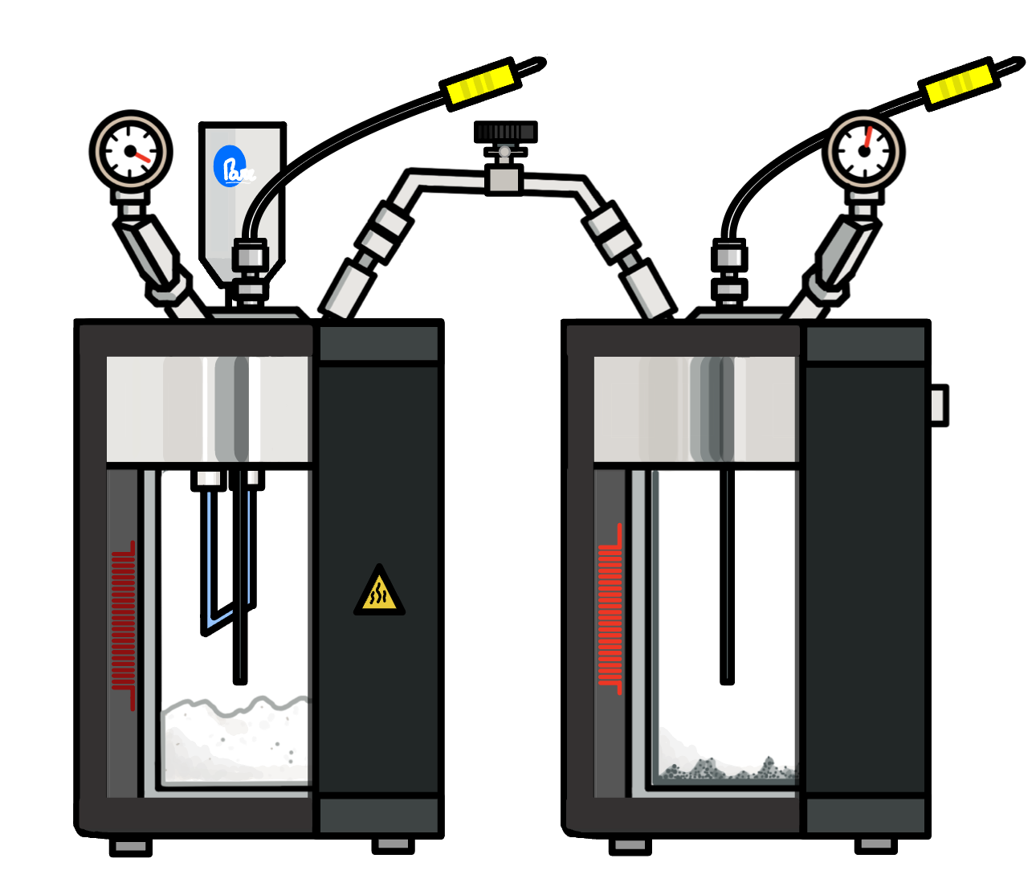
Extracting Iron from Deoxygenated Regolith
Envisioned Iron Scavenging and Processing
Magnetic Concentration
Carbonyl Iron Refining
Steel Part Formation
Finishing
Produces a high-purity, ultra-fine, spherical iron powder ideal for versatile additive manufacturing.
Extracts, concentrates, and purifies iron simultaneously in a compact space. Chamber doubles as a carburization chamber.
Regolith
Loading
Oxygen Extraction
Disposal

Slide 4
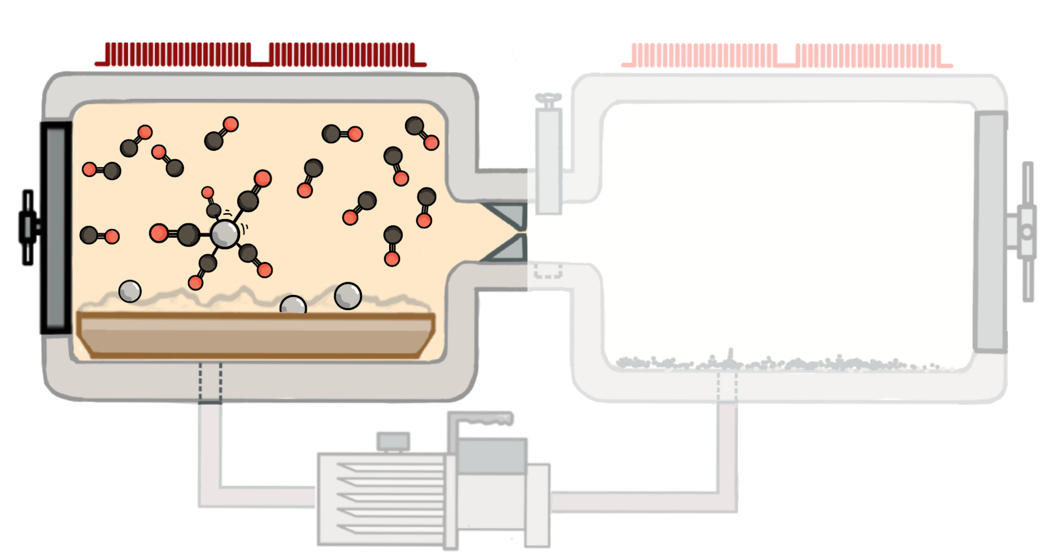
Formation Chamber Principles
Fe_{(s)}+ 5CO_{(g)} = Fe(CO)_{5 (g)}
High CO_{(g)} Partial Pressure
(Industry >200atm)
Moderate Temperature
(Industry 150-200C)

Slide 5
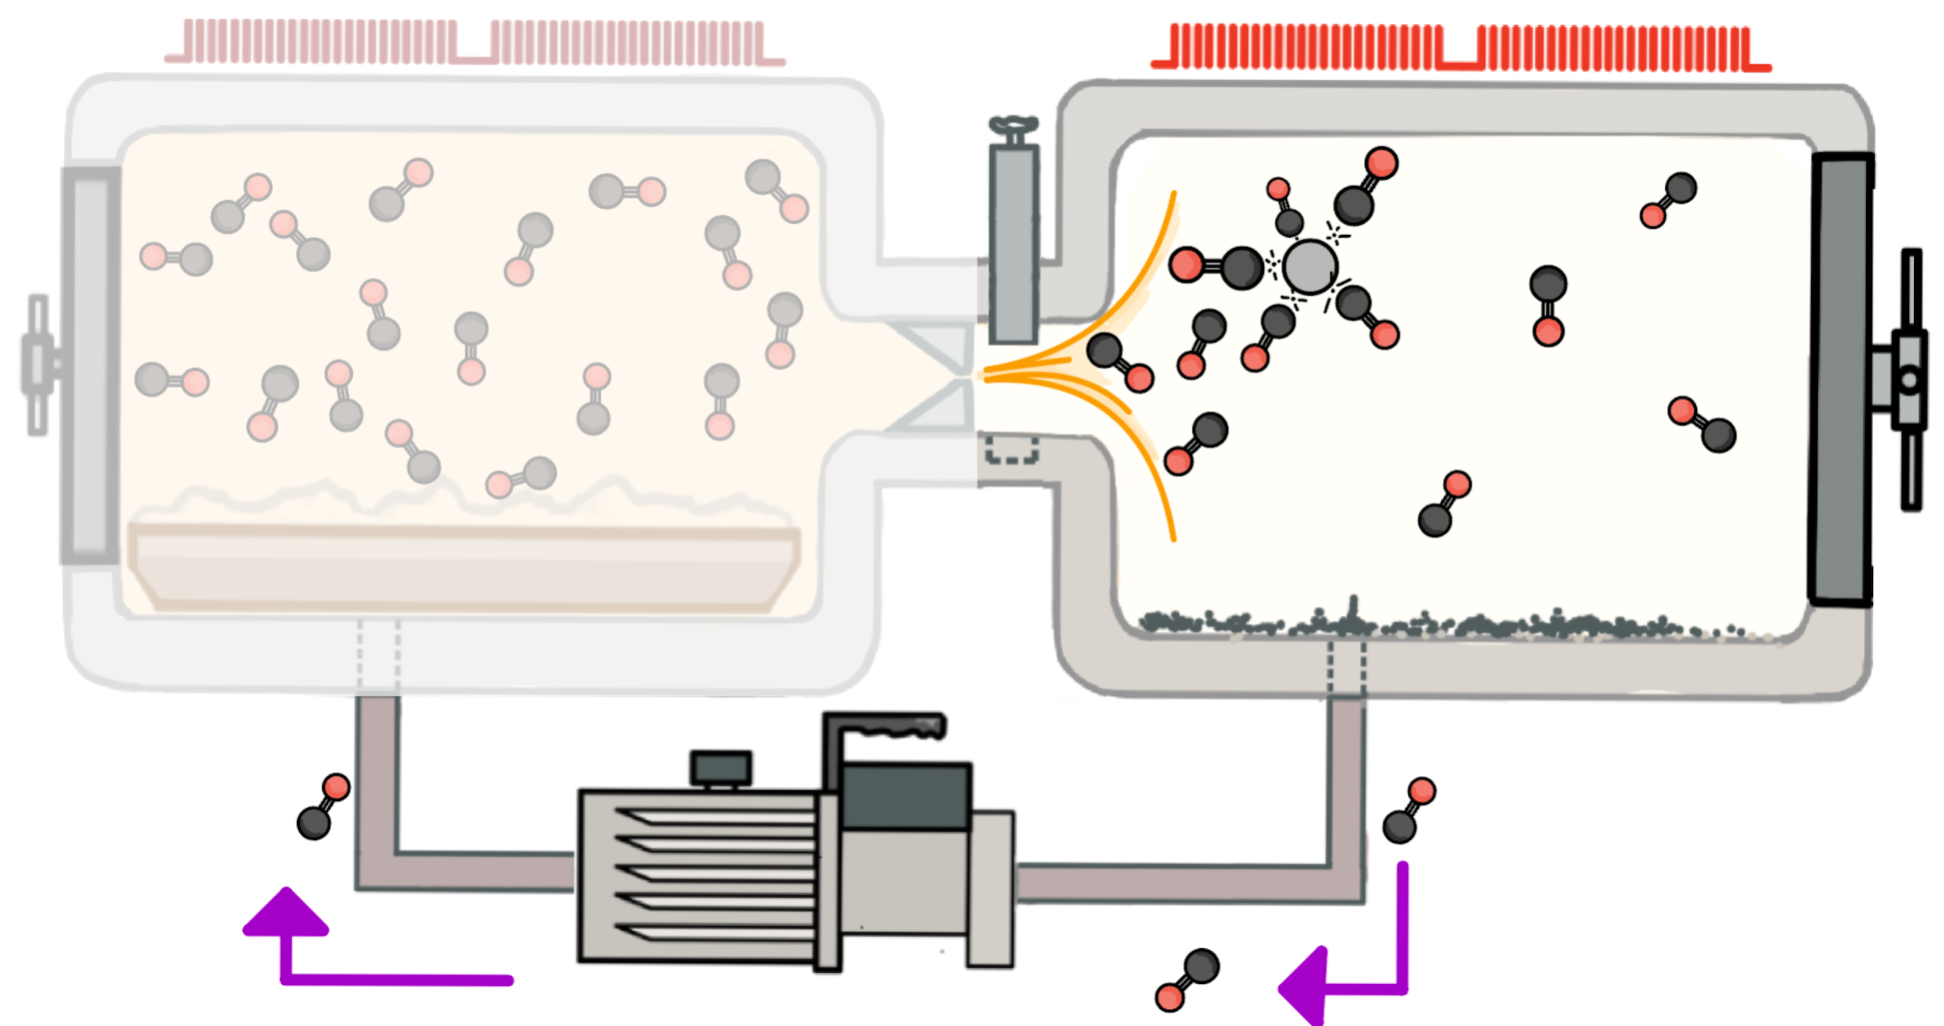
Decomposition Chamber Principles
Fe(CO)_{5 (g)}= Fe_{(s)}+ 5CO_{(g)}
Low CO_{(g)} Partial Pressure
Moderate High Temperature
(250-300C)

Slide 6
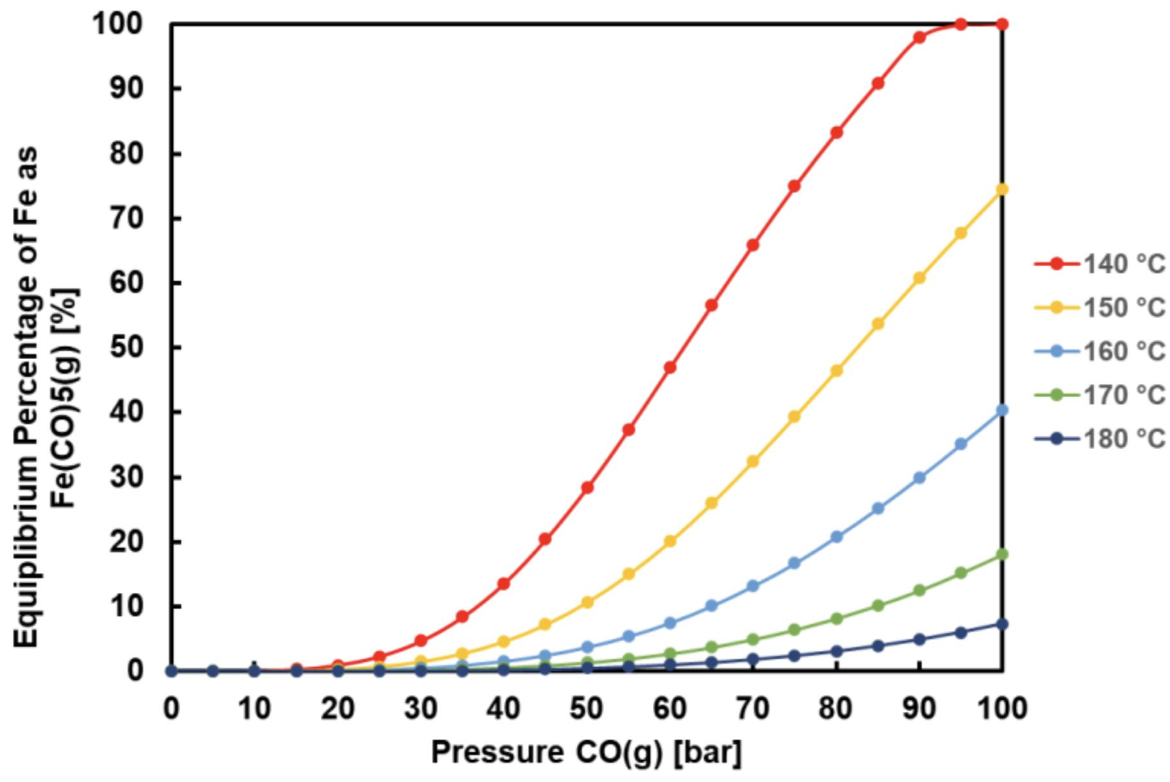
Tailoring Carbonylation to a Lunar Environment
Iron has been commercially produced since 1925 and yields ~29,000 metric tons per year. What is our team proposing that is novel and warrants research?
Industry applies a considerable ~25 MPa (247 atm) of carbon monoxide partial pressure during formation. Allows for 60% of iron to be contained in the gas phase while maintaining reasonable formation kinetics between 180-200C.
Industry needs bulk iron production to be economically viable, leaving low pressure production largely unexplored.
A lunar environment changes the script, where a reduced output is a preferable tradeoff for a significantly lighter apparatus. The benefits of a closed gas loop, AM compatible product, and multistage compaction are allowed to shine.
.
HSC data shows promise in the reduced pressure range (right)
The literature data that could be located (each on laterite ore) both supported the feasibility of outputs that would justify lunar deployment, such as Terekhov & Emmanuel, 2013 with 75% yield in 48 hours.

Slide 7
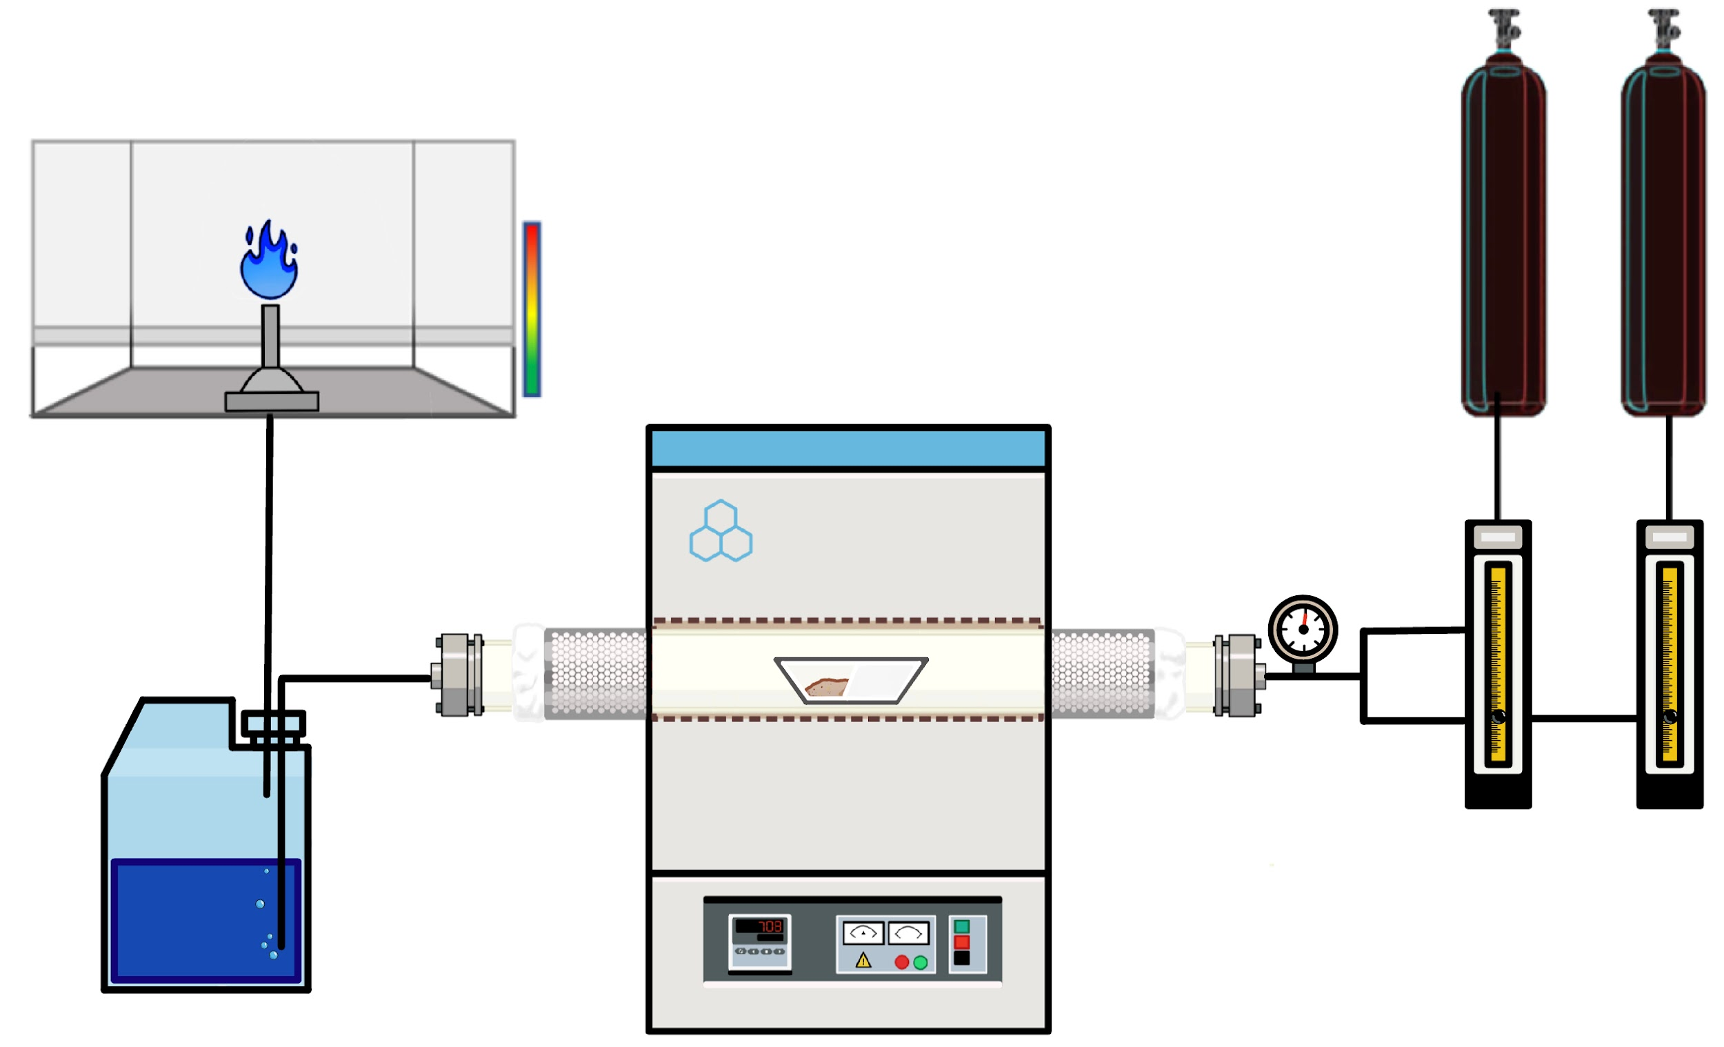
Experimental Plan
Stage 1: Reduction
Stage 2: Carbonylation
Stage 1: Reduce imitation regolith with reactive gas to build a small stockpile for carbonylation. Note magnetic concentration efficiency and reduction observations.
Stage 2: Produce and analyze iron product as a proof of concept, ideally sufficient to print a small component. Record yield as a function of varied pressure, temperature, and flow rate. Watch for and mitigate heterogeneous nucleation.

Slide 8
Reduction System
CO or H₂
N₂
Reduction Furnace

Slide 9
Reduction Procedure and Results
The lunar regolith powder was dried at 200°C for 24 hours before each experiment.
The samples were heated/cooled slowly at a rate of 1 °C/min to avoid cracking the alumina tub, usually to 1000C. Experiments were performed with 100 mL/min of CO(g) (500% excess) for 3 hours. Later, hydrogen.
In addition to dried simulant, some samples were oxidized in air or mixed with carbon.
Quantifying reduced iron was difficult, with XRD, XPS, and mass change confirming the presence of metallic iron but with disagreement in value.
Sample | Metallic iron wt% | Percent of available iron reduced
Simulant, CO exposed | 2.150 | 32.16%
Air oxidized simulant, CO exposed | 2.539 | 37.98%
Simulant, H₂ exposed | 2.928 | 43.80%

Slide 10
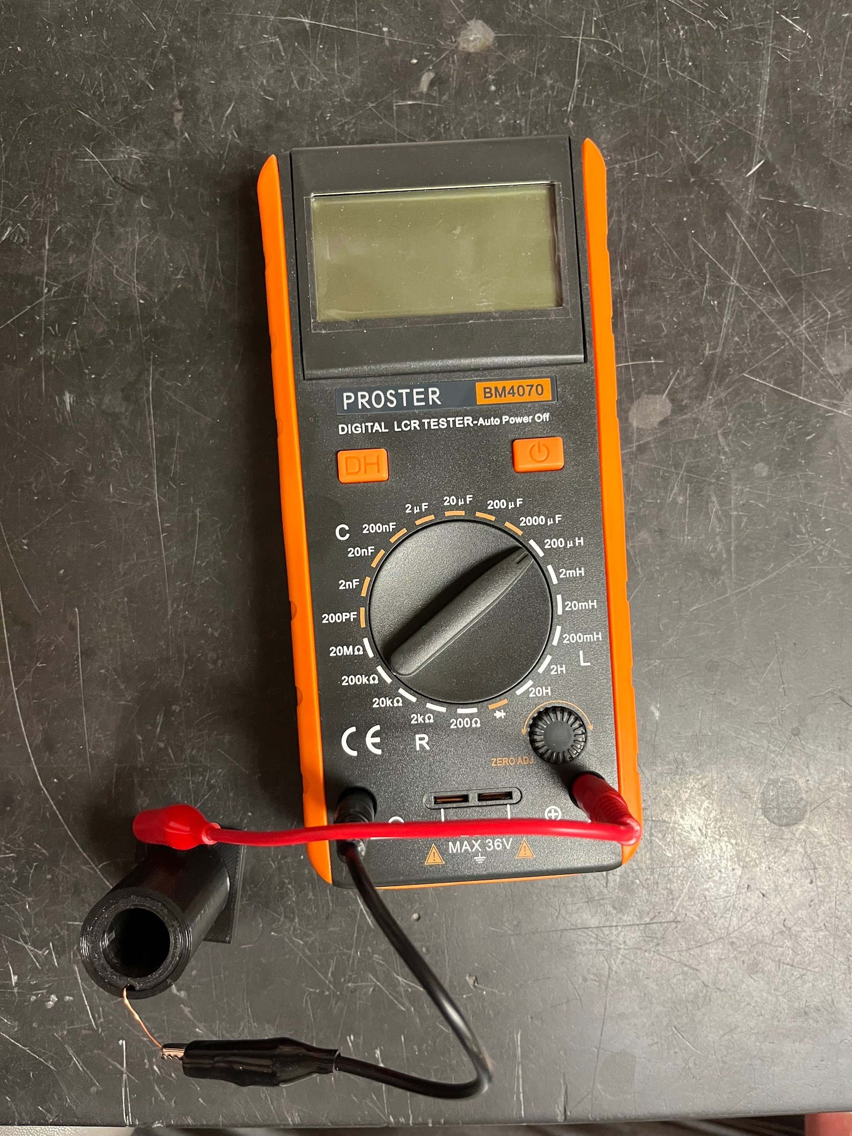
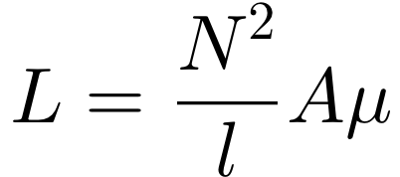
Induction Iron Determination
Inductance L in a non-air core magnetic coil is dependent only on the magnetic permeability of the core material, if the geometry of the coil is kept constant.
Samples of the isolated regolith constituents had a mostly negligible effect on induction compared to an empty coil.
Linear relationship found for iron content when mass is controlled.
Constituents | Empty Inductance | Full Inductance | Change
Ilminite | 152.9 | 153 | 0.1
Olivine | 152.8 | 152.8 | 0
Pyroxene | 152.8 | 152.9 | 0.1
Basalt | 152.8 | 153.2 | 0.4
Anorthsite | 152.8 | 152.8 | 0
Metallic iron* | 152.8 | 178.3 | 25.3

Slide 11
Formation
Chamber
Decomposition Chamber
Vacuum Pump

Slide 12
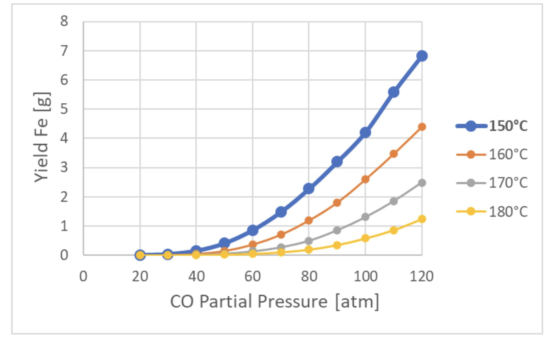
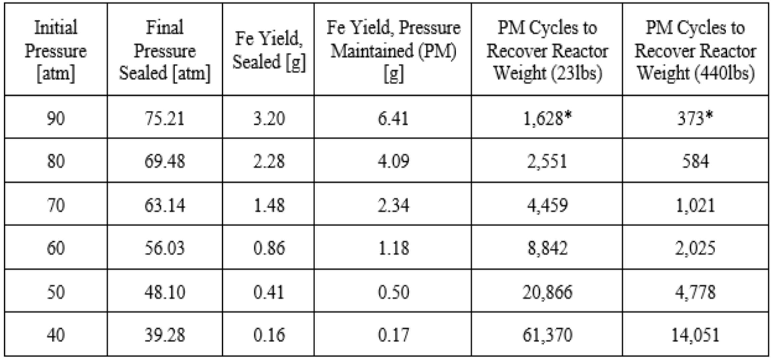
System-Specific Yield Predictions
In the interim before pressure equipment could arrive, thermodynamic data was coded with system conditions, such as particle porosity and changing gas volume.
Data assumes a 10% solid loading at 10 wt% Fe. This is out of a total of 19g of Fe present.
The code predicts the number of cycles to produce iron outweighing the apparatus, scaled up to 440 lbs.
The feasibility depends on the kinetics to complete a cycle. Continuous flow is especially promising.

Slide 13
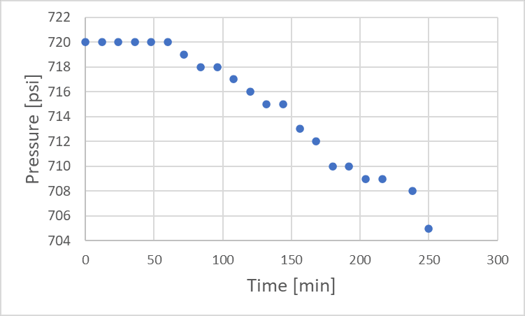
First Carbonylation Results
Used iron powder cleaned with hydrogen for 3 hours at 600C.
Formation chamber was at 50 atm and 150C.
Sealed batch.
The reduction in pressure is. used as a way of tracking the reaction progress, with 5 mol of CO being consumed to form 1 mol Fe(CO)5.
The post-experiment sample was 0.1837g lighter than the start. The loss of pressure corresponds to an expected 0.246249g Fe in the gas phase.
Promising start. Approached the expected equilibrium pressure of 48 atm in a little over 4 hours.
Likely plated on the protective sheathing. Will require additional data.

